Slide 1



Fake News Detection Using Machine Learning
Presented by:-
Utsav Kashyap
Rahul Kumar
Saurabh Kumar
Aryan kumar

Slide 2

01
Introduction

Slide 3


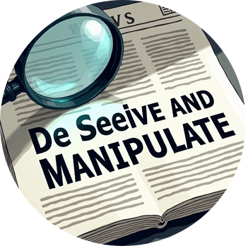
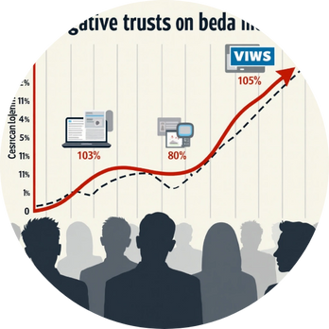
Understanding Fake News
Definition
Purpose
Impact
Fake news is misleading information presented as real news.
False information diminishes public confidence in media.
It aims to deceive and manipulate public opinion.

Slide 4
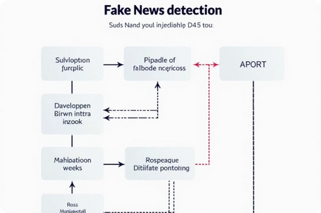
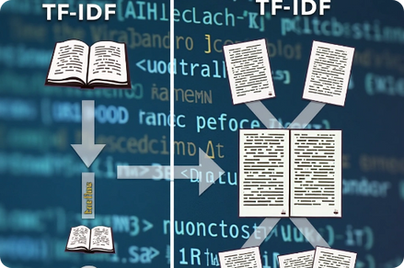
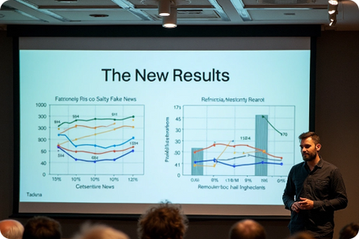


Project Objectives
Pipeline Construction
Text Vectorization
Feasibility Demonstration
Use TF-IDF to convert text to numerical form.
Build a robust ML pipeline for detecting fake news.
Show practical use of ML models in detection.
Dataset Analysis
Model Evaluation
Analyze and clean datasets of fake and true news.
Train and evaluate model using various metrics.

Slide 5

02
Proposed Method

Slide 6



Architecture of Proposed Method
Feature Engineering
Data Acquisition
(TF-IDF Vectorization)
Model Evaluation
1
2
3
4
5
6
Text Preprocessing
Model Training
Model Deployment (Persistence)

Slide 7



Data Acquisition
Text Preprocessing
Feature Engineering
Load labeled fake and real news datasets from Kaggel.
Combine the title and text fields.
Use Tf-idf Vectorizer to transform preprocessed text into numerical feature vectors.
Merge them into a single DataFrame with corresponding labels (0 = Fake, 1 = Real).
Clean the text using regular expressions.
Limit features to the top 5000 most informative terms.
Remove stopwords and convert to lowercase.

Slide 8



Model Training
Model Evaluation
Model Deployment
Train a Passive Aggressive Classifier on the TF-IDF vectors.
Visualize performance using matplotlib and seaborn.
Serialize the trained model and vectorizer using pickle.
Use metrics such as accuracy, confusion matrix, and ROC-AUC.
These can be loaded into a web application or Streamlit interface for real-time use.
Split the dataset into 80% training and 20% testing.
Optimize for speed and binary classification accuracy.

Slide 9



NLP and Feature Engineering Techniques
Text Cleaning
Text Normalization
Context Improvement
Regular expression-based cleaning to remove non-alphabetical characters.
Lowercasing and stop word removal using NLTK's stop word corpus.
Combining title and body text to improve context coverage.

Slide 10

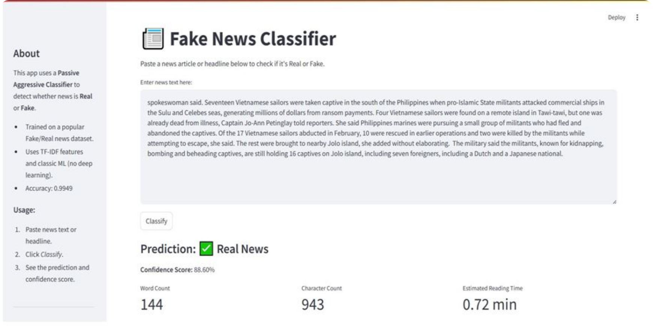
User Interface

Slide 11

03
Result and Analysis

Slide 12

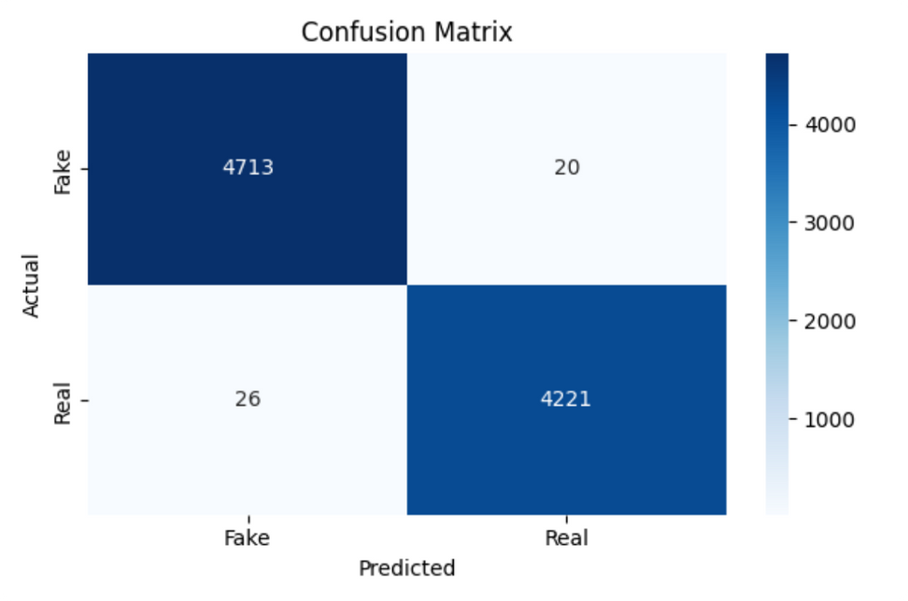
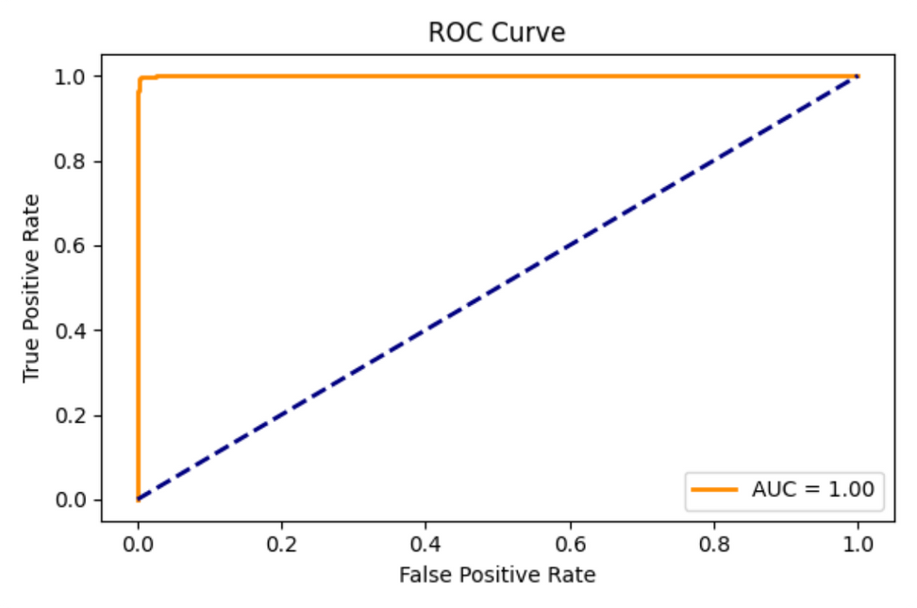
ROC Curve
Confusion Matrix Analysis
The Receiver Operating Characteristic
A confusion matrix was plotted to visualize the distribution of predictions.
ability to distinguish between the two classes.

Slide 13




Evaluation Metrics
These metrics demonstrate high model performance with excellent unseen data
99.49%
99.52%
99.38%
99.45%
Proportion of total correct predictios
Proportion of true positives out of predicted positives
Proportion of true positives out of actual positives
Harmonic mean of precision and recall

Slide 14
04
Summary and Future Work

Slide 15


Summary and Next Steps
Summary
Next Steps
Make the model work with non-English and local language news. Add live datasets. Connect with knowledge graphs or reliable fact-checking APIs to check facts directly.
The project showed that using machine learning with TF-IDF for features and the Passive Aggressive Classifier for training can find fake news with about 99.49% accuracy.

Slide 16

Thank You !

